Slide 1
DS&AI Project Event Calculus and Transaction Logic
Marcello Bonsangue
LIACS – Leiden University
m.m.bonsangue@liacs.leidenuniv.nl
Reusing slides from Jacques Robin

Slide 2
Outline
The Event Calculus
Limitations and comparison with SC
Transaction Logic
Limitations and comparison with SC, EC

Slide 3
The Event Calculus (EC)
Exists in various version of increasing expressiveness
Most expressive versions overcome all the expressiveness limitations of the SC except the qualification problem
Also more time efficient than the SC for relying on abductive logic programming in Horn first-order logic instead of theorem proving in classical first-order logic
Explicitly represents time points, time intervals, punctual events, events with durations, sequential and concurrent events
An agent executing an action is a special case of event
not(holds(Fluent))
holds(Fluent)
not(holds(Fluent))
t
terminates(Event,Fluent)
initiates(Event,Fluent)

Slide 4
General logic programs
General (or normal) logic programs extend pure (or definite) logic programs with Negation As Failure (NAF) connective not that can precede atoms in a clause premise
Inference engine is extended with step to prove premise not A
Generally it tries to prove goal A:
if it succeeds, then not A fails
if it finitely fails to do so, it assumes A false (negatively abduces A) and not A succeeds
abducing not A from failure to prove A it is a completely different inference than deductively proving ¬A in classical first-order logic

Slide 5
General logic programs
Tabled logic programming engine can detect loops through NAF such as query q with program {p :- not q. q :- not p.}
It computes the Well-Founded Semantics (WFS) in ternary logic
When A neither succeeds nor can it finitely fail due to NAF loops, the WFS assigned truth value unknown to both A and not A

Slide 6
Representing a domain with EC
Domain-dependent knowledge represented as abductive logic program clauses using EC predicates:
holds_at(F,T): fluent F is true at time T
precond(E,T): precondition of event E are fulfilled at time T
do(A,T): action A is executed at time T
happens(E,T): event E occurs at time T
initiates(E,F,T): fluent F becomes true as a positive effect of event E
terminates(E,F,T): fluent F becomes false as a negative effect of event E
clipped(F,T1,T2): fluent F becomes false between time T1 and time T2

Slide 7
Representing a domain with EC
Domain-independent EC clauses that specify generic relations between EC predicates, that axiomatize their temporal reasoning semantics
holds_at(F,T2) :- happens(E,T1), initiates(E,F,T1), T1 < T2, not clipped(F,T1,T2).
clipped(F,T1,T3) :- happens(E,T2), terminates(E,F,T2), T1 < T2, T2 < T3.
happens(E,T) :- precond(E,T), not action(E).
happens(E,T) :- precond(E,T), action(E), do(E,T).

Slide 8
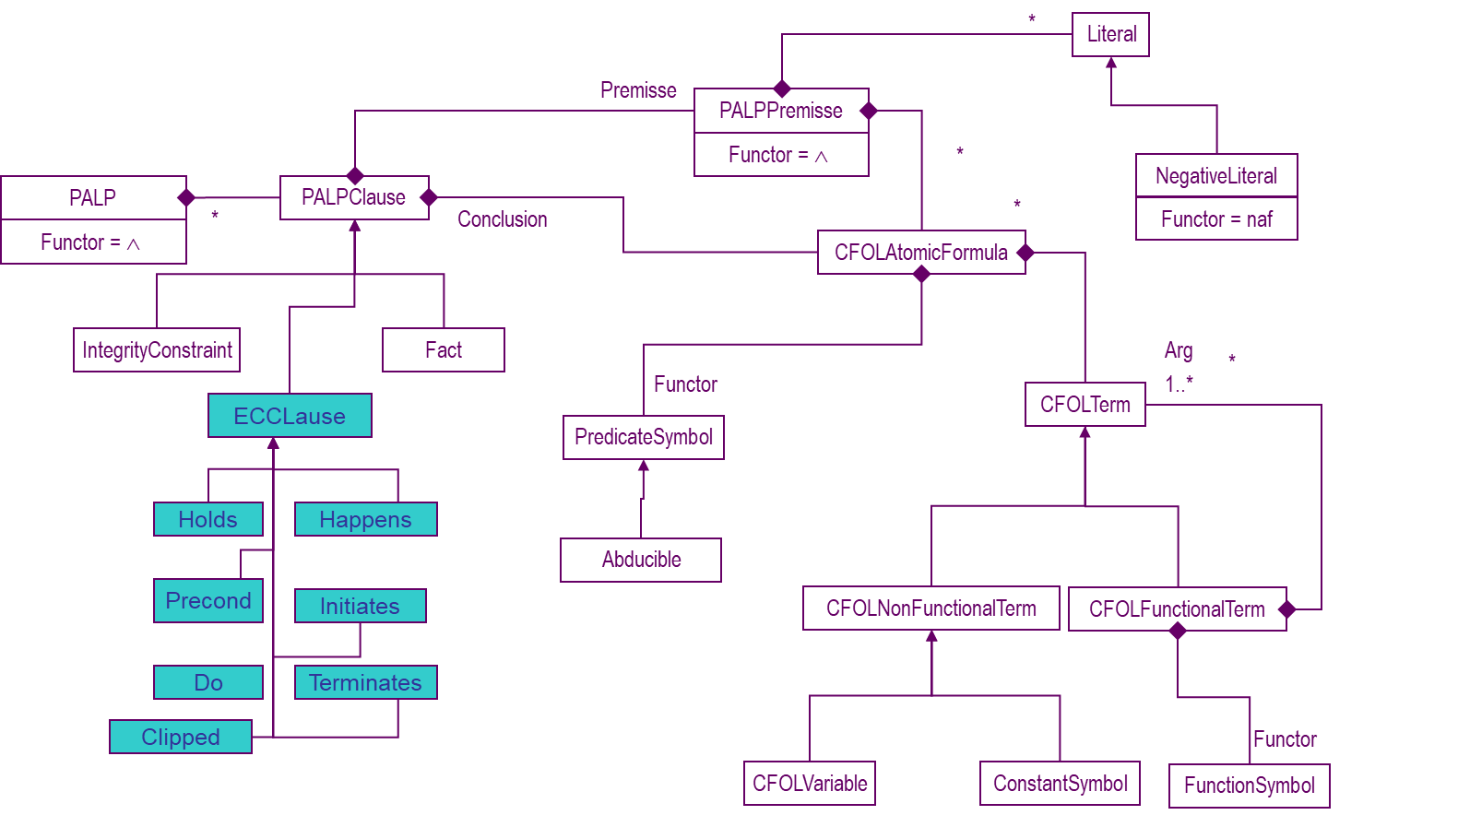
Ontology of the Event Calculus

Slide 9
Illustrative case study: the block world
Agent: robot with one arm building stacks from blocks on a table
Eternals:
isclear(table)
block(B)
Fluents:
on(Block,Loc)
isclear(Loc)
above(B1,B2)
Action: safeMove(B,L1,L2)
preconditions
on(B,L1) ∧ isclear(L2) ∧ isclear(B)
intended effects
¬on(B,L1) ∧ on(B,L2)
side effects
block(L2) ⇒ ¬isclear(L2)
a
a
b
b
c
c
table
table
Action: riskyMove(B,L1,L2)
preconditions
on(B,L1) ∧ isclear(L2)
intended effects
¬on(B,L1) ∧ on(B,L2)
side effects
∀X, above(X,B) ⇒ (¬above(X,L1) ∧ above(X,L2))
block(L2) ⇒ ¬isclear(L2)

Slide 10
Block world EC clauses
Initial state clauses:
holds_at(on(a,b),0). holds_at(on(b,c),0). holds_at(on(c,table),0). holds_at(isclear(a),0).
Precondition clauses:
precond(safeMove(B,L1,L2),T) :- holds_at(on(B,L1),T),
holds_at(isclear(L2),T),
holds_at(isclear(B),T).
Positive effect clauses:
initiates(safeMove(B,L1,L2), on(B,L2),T).
initiates(safeMove(B,L1,L2), isclear(L1), T).

Slide 11
Block world EC clauses
Negative effect clauses:
terminates(safeMove(B,L1,L2), on(B,L1),T).
terminates(safeMove(B,L1,L2), isclear(L2), T).
Ramification clauses:
holds_at(above(B1,B2),T) :- holds_at(on(B1,B2),T).
holds_at(above(B1,B3),T) :- holds_at(on(B1,B2),T), holds_at(above(B2,B3),T).

Slide 12
Variations of the EC
Basic EC already handles concurrent actions and time intervals
Additional arguments to EC predicates and additional EC clauses allow extending basic EC to handle:
Events with duration: happens(E,T1,T2)
Multiple agents: do(Agent,Action,T)

Slide 13
EC vs. SC
Most expressive versions overcome all the expressiveness limitations of the SC except the ramification problem
Also more time efficient than the SC for relying on abductive logic programming in Horn first-order logic instead of theorem proving in classical first-order logic

Slide 14
Abductive logic programming
Extend general logic programs with:
Integrity constraints I
A distinguished subset of predicate symbols called abducibles
Atoms with an abducible functors (abducible atoms) are generally restricted to appear only in clauses premises
they have no definitions where they appear in conclusion

Slide 15
Abductive logic programming
An abducible atom goal is assumed true (positive abduction) whenever:
Its assumption does not allow deducing conclusions that violate the integrity constraints
Abduction can be used to construct plans using an EC representation of the domain D:
holds atoms represent the goal G to be reached
do atoms represent the hypothesis H to abduce
The abductive proof procedure computes H such that:
D ∧ H |= G
D ∧ H ∧ I |≠ false

Slide 16
Transaction Logic (TL): starting point
A set of Prolog clauses defining a predicate have two distinct semantics:
A declarative, logical one (Clark’s completion or least Herbrand model)
A procedural one (implicit)
Example
p :- q, r.
p :- u.
Declarative semantics: p ⇔ ((q ∧ r) ∨ u)
Procedural semantics:
define p {{call q; if q = true then {call r; return r} else return fail}; {call u; return u}}
In the declarative semantics the order of q, r and u does not matter
In the procedural semantics, the order is crucial
Transaction logic unifies the two semantics by representing the procedural one explicitly and declaratively

Slide 17
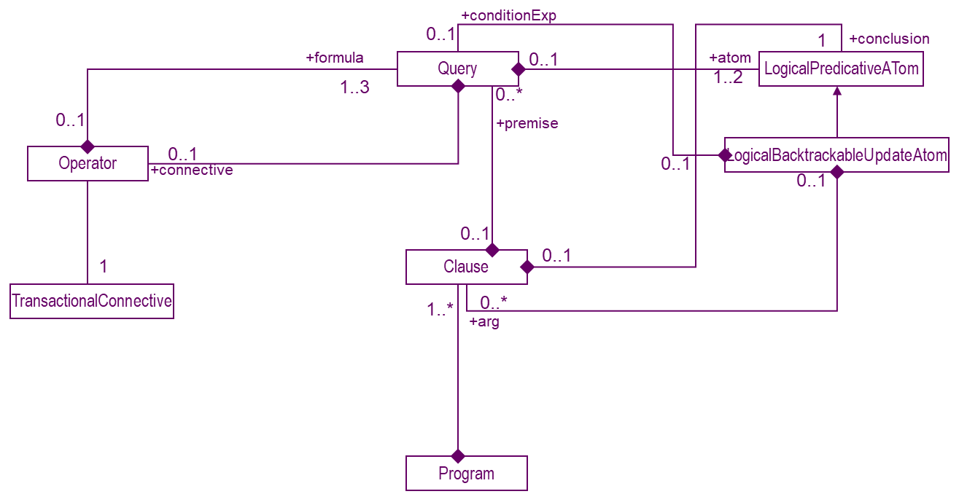
Ontology of the Transaction Logic

Slide 18
Transaction logic connectives
Extends normal logic programs with backtrackable clause update predicates and two new connectives
btinsert{C1, ..., Cn} premise has side effect to explicitly add clauses C1, ..., Cn to the logic program
btdelete{C1, ..., Cn} premise has side effect to explicitly delete all clauses that match C1 or ... or Cn from the logic program

Slide 19
Transaction logic connectives
Serial conjunction ⊗:
Declaratively captures procedural semantics of Prolog’s conjunction
Distinct from classical conjunction
In TL: a, b ⇔ b, a, but a ⊗ b ⇔ b ⊗ a
Serial disjunction ⊕:
Declaratively captures procedural semantics of Prolog’s disjunction
Distinct from classical disjunction
In TL: a; b ⇔ b; a, but a ⊕ b ⇔ b ⊕ a
Transaction semantics:
If one element of a serial conjunctive premise fails
ex, r fails in c :- btinsert(a) ⊗ btdelete(b) ⊗ r ⊗ s
then b is put back in the KB and a is retracted from it

Slide 20
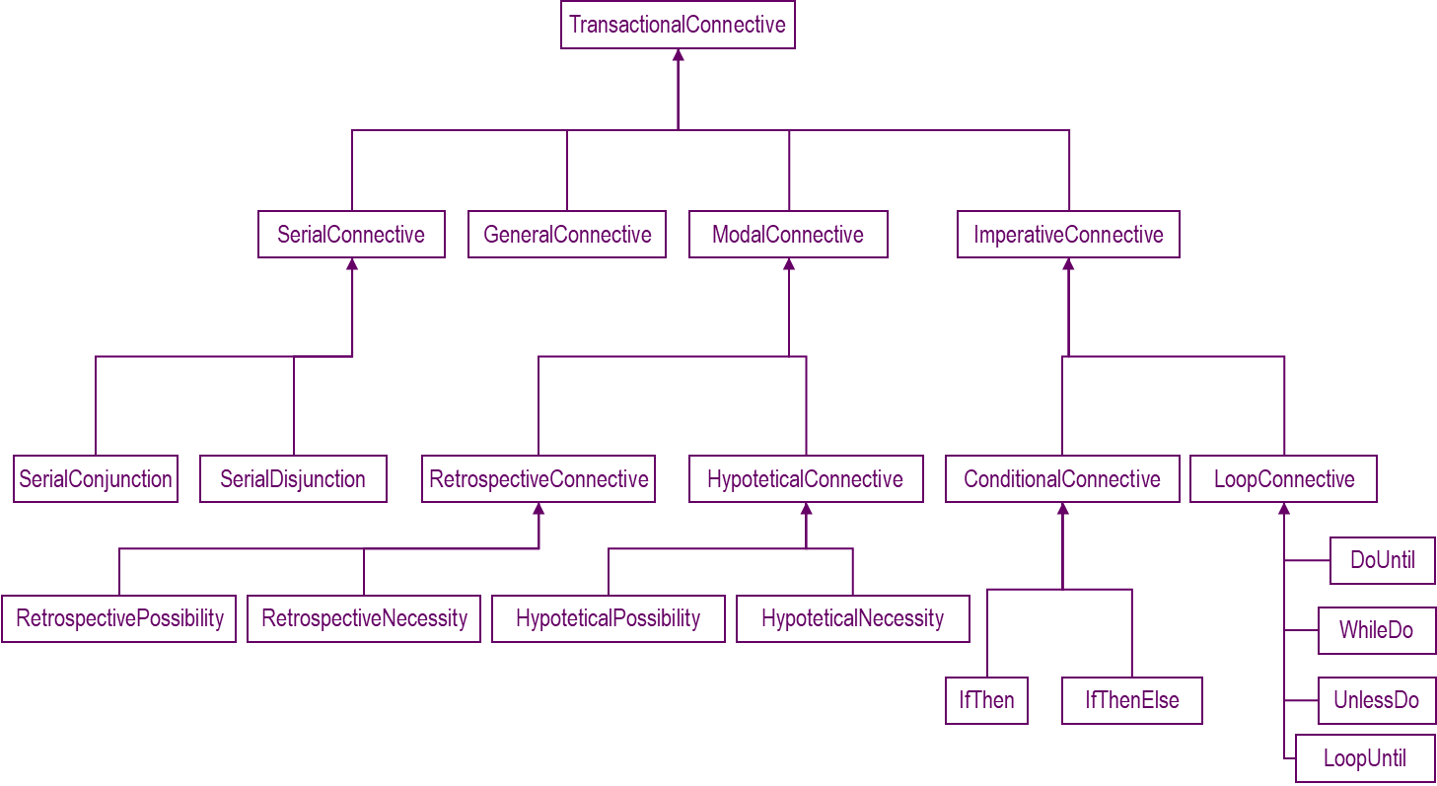
Ontology of the Transaction Logic Operators

Slide 21
The block world in TL
Initial state clauses:
block(a). block(b). block(c). on(a,b). on(b,table). on(c,table). isclear(table).
Ramification clauses:
isclear(B) :- block(B), not(on(C,B)).
above(B1,B3) :- on(B1,B2) ; (on(B1,B2), above(B2,B3)).

Slide 22
The block world in TL
Precondition clauses:
preconds(safeMove(B,L1,L2)) :- on(B,L1), isclear(B), isclear(L2).
Effect clauses:
effects(safeMove(B,L1,L2)) :- btdelete(on(B,L1)) ⊗ btinsert(on(B,L2)).
Action execution clauses:
do(A) :- preconds(A) ⊗ effects(A).
Planning clauses:
achieve(Goal) :- Goal.
achieve(on(B,L)) :- do(safeMove(B,_,L)).

Slide 23
TL vs. EC vs. SC
TL far more space and time efficient than EC and SC
Because it does not keep the history of the environment
It only maintains its current state
But this history is available in the trace of its proof mechanism that can be backtracked upon demand
Like SC and unlike EC, TL does not explicitly represent time points and durations
With additional arguments and clauses it does concisely and efficiently support planning and temporal projection
Complex, chained ramifications require truth-maintenance which is not supported as built-in by available TL engines

